Slide 1

Introduction to Field Service
DYNAMICS 365

Slide 2

Mitch Milam
mitch@xrmcoaches.com
@mitchmilam
linkedin.com/in/mitchmilam
youtube.com/xRMCoaches

Slide 3
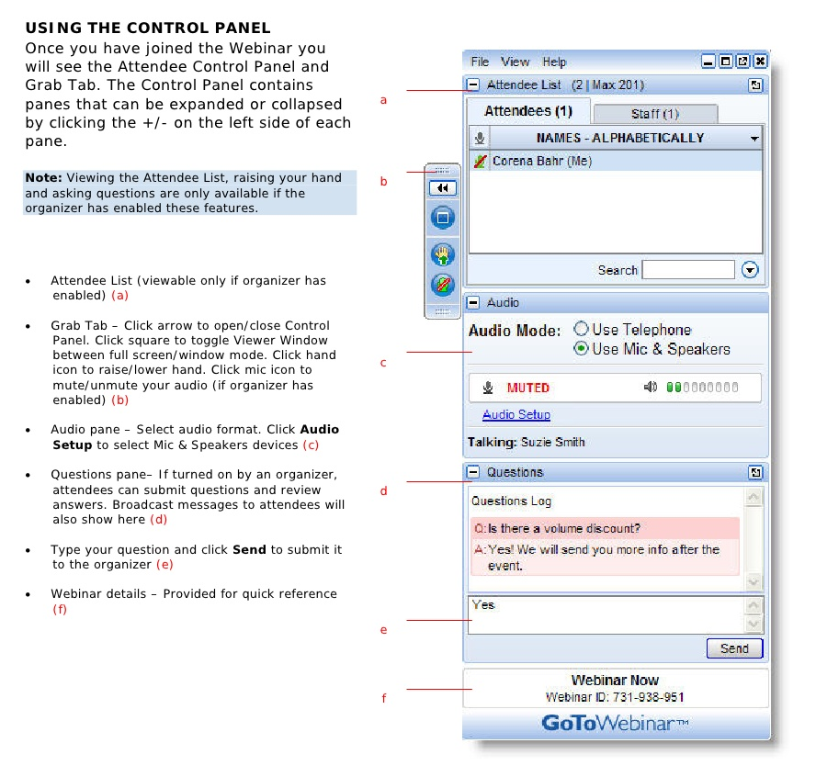
Webinar Housekeeping

Slide 4
Agenda
When
Where
Why
Technology
Tools

Slide 5

Announcements

Slide 6
Announcements
New Online Course Offerings
Dynamics 365 JavaScript Development
Learn.xrmcoaches.com

Slide 7
Introduction

Slide 8
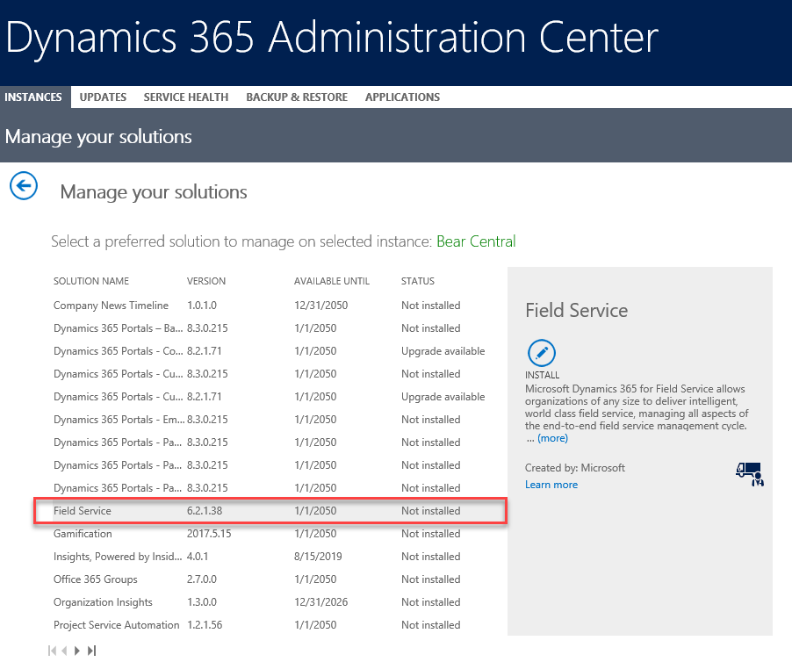
Installation

Slide 9
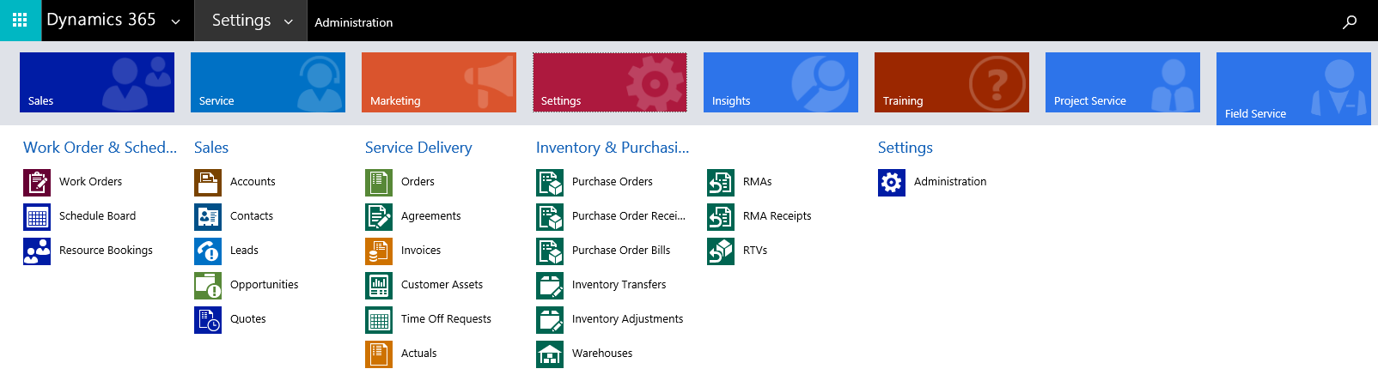
User Interface

Slide 10
PSA and Field Service
How does Project Service Automation work with Field Service?

Slide 11
Field Service Demo Data
Download
https://www.microsoft.com/download/details.aspx?id=55320

Slide 12











Microsoft Dynamics 365
Project Service Automation
Cortana Intelligence
Power BI
Finance and Operations
Sales
Azure IoT
PowerApps
Microsoft Flow
Common Data Service
Customer Service
Talent
Marketing*
AppSource
Retail
Field Service
*Brought to you by Adobe Marketing Cloud
Notes:
Microsoft Dynamics 365 for Customer Service improves each step of the service experience. Our service solution is part of Microsoft Dynamics 365, which is the next generation of intelligent business applications, helping organizations engage customers, empower employees, optimize operations and find new ways to provide value to their customers.
These applications work seamlessly together to manage specific business processes across, Sales, Customer Service, Field Service, Operations, Project Service Automation and Marketing. This is exciting as we help businesses deliver compelling and personalized experiences through every phase of their customer relationships.
What makes Dynamics 365 unique is that it harnesses the power of One Microsoft. Data has become the new currency, and organizations create and have access to more of it, and faster than ever before. The challenge is how to transform it into intelligence that generates action and drive outcomes. Dynamics 365 will allow organizations to adopt individual business apps such as Marketing, Sales, Service and Operations, but as organizations adopt more of the apps, synergies will be unleashed in the form ‘Intelligent Business Processes’. This will help proactively guide employees & customers to generate optimal outcomes.
It sounds basic… but the fact is that the classic delineation between CRM and ERP has created a separation in data and processes. Dynamics 365 breaks down this separation, and our business platform strategy together with CIT and IOT is centered on enabling this to new levels.
Sample narrative
Let’s take a step back and quickly look how customer service fits into the bigger Microsoft Dynamics 365 picture. Dynamics 365 is Microsoft’s next generation of intelligent business applications, helping organizations engage customers, empower employees, optimize operations and find new ways to provide value to their customers.

Slide 13



Dynamics 365 for Customer Service
Earn customers for life
Customer & employee self-service
Service intelligence
Omni- channel
Agent enablement
Customer
Agent
?
Knowledge
Notes:
Sample narrative
Dynamics 365 for Customer Service helps enable this digital transformation and improves every aspect of customer service. And that’s important, because customer experience is on track to overtake both price and product as the key brand differentiator by 2020, according to the Walker 2020 Customers report.
We help improve the experience through five key capability sets: omni-channel engagement, self-service and communities, agent enablement, unified knowledge and service intelligence.
Let’s take a look at each of these capabilities.

Slide 14

Customer & employee self-service
Knowledge Enhanced knowledge management with product filtering and content access levels.
Discussion Forums Deepen customer relationships and loyalty with conversations between employees, customers and experts.
Support Reduce support costs by enabling case deflection, exposing knowledge articles and forum content in search.
84%
of consumers use web or mobile self-service to find answers
Kate Leggett, Trends 2016: The Future Of Customer Service, Forrester, January 2016
Notes:
By enabling a customer self-service experience as an additional support offering, organizations help to meet the desires for their customers to quickly answer their questions with the web enabled device of their choice. Providing knowledge to customers through a portal deflects higher cost support options in the traditional customer service model and allows your support agents to focus their time on the more complex issues. With a self-service portal customers receive the support they desire, access to discussion forums that build customer loyalty, access to their support entitlement data and the ability to provide organizations with feedback through polls, ratings and comments.
Employee self-service empowers employees by providing secure access to knowledge that helps employees increase productivity. Employees are able to find answers to commonly asked questions, participate in communities within their organization and share feedback. The employee self-service portal functions in the same way that a customer portal does with authentication that verifies their employee status. Examples of employee self-service task includes managing internal processes such as HR assistance, IT helpdesk and facilities requests. There are also licensing differences that you should be aware of and are covered in the monetization session.
For the Fall 2016 Release we have enhanced Knowledge management with product and faceted search, you can now surface more relevant knowledge articles based on the portal users’ product ownership. You will also be able to restrict access to knowledge articles based on portal users’ Content Access level.

Slide 15

Agent enablement
Role driven Drive the next best action through a visual user interface that delivers role tailored experiences for tiered agents and support leads.
Intelligent case management Speed resolution with machine learning and advanced analytics capabilities, and a dynamic interface that guides agents through every interaction.
Collaborative
Avoid escalations by harnessing the knowledge of peers and subject matter experts both inside and outside the service organization.
4%
of service organizations can solve an inquiry using a single application
Kate Leggett, The Mandate For Intelligent Customer Service, a commissioned study conducted by Forrester Consulting on behalf of Microsoft, December 2015
Notes:
Customer Scenarios: Network Contacts
https://customers.microsoft.com/Pages/CustomerStory.aspx?recid=27990
Because its call center agents work with so many different enterprise end customers, agents need access to fast, centralized information in order to provide the best possible service. Using Dynamics 365 for Customer Service, the same number of agents are able to handle more calls, and each issue is resolved more quickly.
Capabilities:
Agent enablement- Empower agents with a single, unified experience to deliver fast, amazing customer service from the desktop or their mobile device. Agents can access every source of information they need across diverse environments so they can provide a more personalized, effective standard of service.
Role Driven: Dynamic interface that contextually serves up the tools, guidance and data to your agents
Visual user interface delivers role tailored experiences for tiered agents and support leads; optimized to drive to the next best action
Reduce agent effort with a single, extensible application to handle all service interactions in a single place. The Unified Service Desk provides a single (composite desktop), dynamic interface that contextually serves up the tools, guidance and data to your agents from any resource you deem useful.
Expand your notion of an agent by giving agents and supervisors the freedom of mobility and extending the reach of your contact center across your organization anywhere, anytime.
Intelligent Case Management: Manage cases faster & provide differentiate levels of support with integrated knowledge
Manage cases faster & provide differentiate levels of support with integrated knowledge, SLA, scripting, workflow, entitlements and recommendations
Manage your cases faster – from your desktop or mobile and enable your agents to deliver world class case management while providing differentiated levels of support with guided workflow, integrated knowledge, entitlements and SLAs
Increase agent effectiveness with call scripting and a proactive user experience that will launch information assets or third party data and applications to provide rapid and accurate service resolution. (Increase agent effectiveness with call scripting, policy adherence with a proactive & process driven user experience)
Collaborative:
Harness the knowledge of your peers with Yammer and Skype
Speed resolution of even the most challenging issues with instant access to support professionals and subject matter experts across internal and external teams with Yammer & Skype.
Sample narrative
Even though most of us prefer to solve issues on our own, we still rely on agents for the really tough issues we can’t solve on our own. So if I’m an agent, a disproportionate number of the questions coming into my queue are getting harder and harder for me to solve. In fact, there’s been a 12% decline in first call resolution since 2009. As an agent, if I don’t have the tools and resources I need to address those tough cases, I will be frustrated and overwhelmed because I’m not empowered to be successful in my job. As a customer, I am frustrated as well. Given the circumstances, both the agent and the customer are likely to leave the brand in search of better experiences.
Agents using our solution are empowered with a single, unified experience that can be delivered on their desktop or mobile device. From this single application interface, they can access every source of information they need – including third party data and applications - to provide a more personalized and effective service. Throughout every interaction, a role driven dynamic interface contextually serves up tools, guidance and data to agents so they can be more effective.
Integrated knowledge, SLAs, agent scripting, workflow, entitlements, and recommendations help agents manage cases faster, and collaboration tools connect agents with peers and subject matter experts across internal and external teams to help speed resolution and avoid escalations.
Advanced analytics and machine learning scenarios also help agents solve cases faster by surfacing relevant knowledge articles and related cases during the course of solving an inquiry – meaning successful outcomes of previous cases can be leveraged to help solve new cases faster, and every agent benefits from each successful resolution.
Learning Path is another great agent enablement tool, which provides context sensitive guidance to help new users navigate the application and perform tasks specific to their role.
All of these agent enablement tools decrease resolution times, increase first call resolution rates, decrease training time, and empower agents to provide differentiated levels of support.

Slide 16

Service intelligence
Interactive dashboards Provide real-time views of key service metrics through fully customizable, interactive dashboards.
Customer insight
Deepen customer insight and identify business opportunities by tracking and correlating customer satisfaction with service metrics.
Trends and forecasting
Identify trends, explore scenarios, and forecast outcomes to reduce effort scores, improve performance and identify best practices.
77%
have a more favorable view of brands that offer proactive customer service notifications
2016 Global State of Global Customer Service Report, Microsoft
Notes:
Customer Scenario: Metro Bank
https://customers.microsoft.com/Pages/CustomerStory.aspx?recid=22883
To provide an innovative, personalized service, Metro Bank needs to capture rich detail about its customers, from how long it takes to resolve their questions via telephone call centers, to identifying peak times for transactions conducted via the bank’s mobile app. And those details need to be clear and easy to understand, and available to the right person at the right time. By collecting rich detail and making it easy to analyze through personalized dashboards, Power BI helps bank colleagues identify problems before they can affect the bank’s relationship with the customer. Colleagues can combine details from account activity, data from customer satisfaction surveys, branch traffic patterns and more to understand which proactive solutions can make the biggest difference to the customer experience. Similar survey data offers insight into the employee experience, or what Rioch calls “the voice of the colleague.”
Service intelligence – Identify trends, anticipate opportunities and gain insight through dashboards, deep analytics and powerful data visualization capabilities.
Interactive dashboards:
Provide real-time views of key service metrics with fully customizable & interactive dashboards
Fully customizable, interactive dashboards provide real-time views of key service metrics.
Customer insight: Deepen customer insight & identify business opportunities by tracking & correlating customer satisfaction with service metrics
Deepen customer insight and identify up/cross-sell and service improvement opportunities by tracking and correlating customer satisfaction with service metrics across all channels.
Performance reporting: Identify trends, explore what-if scenario’s, & forecast outcomes to reduce effort scores (Power BI & Excel). Improve performance & identify best practices by correlating agent activity & customer experience data
Identify trends, explore what-if scenario’s, and forecast outcomes to reduce effort scores by leveraging powerful tools such as Excel and PowerBI to generate reports, interactive charts and 3D geospatial visualizations.
Improve performance and identify best practices by correlating agent activity and customer experience tracking track data such as Net Promoter Score, Customer Satisfaction, First call resolution, self-service rate, cost per transaction, order value, and other data with specific interaction types.
Sample narrative
Brands can measure the effectiveness and quality of the service they provide through service intelligence. Service intelligence empowers people at every level of an organization – from agents, service managers and directors, and executive leadership both inside and outside the customer service organization - to have a positive and meaningful impact on business outcomes by providing insights unique to each position.
Our solution offers advanced analytics, and in addition to traditional reports that can be edited inline, displays insights through dashboards with powerful data visualization capabilities. Role-tailored dashboards present real-time and historical data through a visual user interface, and users can drill down into deeper layers using interactive charts and filters. Embedded Power BI enables organizations to also include data from third party applications in their analysis for even deeper insights, analysis and exploration. And - any report or visualization can be instantly rendered using natural language capabilities.
Our solution provides intelligence across transactional data and data streams from connected devices and other big data sources, and this provides organizations with the information they need to offer proactive service, as well as to predict and preempt the need for service in some scenarios.

Slide 17



Microsoft Dynamics 365 for Field Service
Master the service call
Contract management
Customer-centric experience
Technicians
Connected field service
Schedule & dispatch
Inventory management
Mobile
Customers
Operations
Notes:
After a field service organization has made a service agreement with a customer, work that follows needs to be scheduled, documented, completed, and paid for. Let’s take a look at some of our highlights in this process.
As part of Dynamics 365, customer cases and concern calls that originate from any channel, including phone, email, or even social media mentions can be converted into work orders when onsite work is required. In this release, we even accept concern calls from devices. Once a work order is created, the next step is to schedule a person for the work.
Scheduling is important because usually an agent has made a service promise to the customer, so getting the schedule right is imperative to keep that promise. We provide complete flexibility in how organizations choose to schedule their resources by offering manual, assisted, and now in this release, automated, optimized scheduling – more on that later. In each of these workflows, we support our schedulers with visual cues like seeing already scheduled appointments and technician’s driving routes along a map, color coding types of work, and showcasing a large view of the schedule board so schedulers can see where appointment gaps appear.
Part of the dispatch process is ensuring that the right parts are on the truck to get the job done. We leverage inventory management capabilities that capture real time information from deliveries and even from technicians in the field who make live updates around parts consumed. This means the right parts are always ready to go. We also handle returns if a part is defective or needs to be returned for another reason.
It’s imperative that the customer be kept informed at all stages of service delivery. New in this release, field service organizations can leverage an API with Twilio to send automated texts and email reminders and customers can login to an online portal to view upcoming appointments.
On their way to, and at the customer location, we enable technicians with a mobile application that helps them succeed. Each tech updates their status between driving, in-progress work, and completed work. This information allows schedulers to get a real time view of what’s happening with each technician and each job. Data collected over time paints a picture of how long each type of appointment actually takes. The mobile app also empowers the field technician by providing step by step instructions on how to complete the task at hand. The technician can snap photos of the completed work, get customer sign-off, and even collect payment. Organizations who leverage Dynamics 365 for Sales can have technicians identify new opportunities or collect competitive intel about accounts, which can be recorded through the mobile app as well.
Back at headquarters, managers review work orders and close them out.

Slide 18


Schedule & dispatch
Balanced workloads
Identify and organize available resources by category to intelligently balance workloads and resources.
The best technician
Match skill sets of the technician against the requirements of the work order.
Optimized schedules
Decrease driving time between work by creating a schedule with geography, customer preference, availability, and SLAs in mind.
“Every time a service company rolls a truck it costs over $1,000. When you aren’t able to solve the problem on the first visit, you are flushing another thousand dollars down [the drain].”
Notes:
At the heart of field service is the ability to schedule and dispatch a field technician. We have the ability to organize and find available resources by any number of categories, including skill sets, geography, or even by customer preference. Using the drag-and-drop schedule board allows dispatchers to assign resources and set up schedules for multiple work orders using a map or a list view.
Dispatch technicians using optimized routes and skill based assignments to intelligently balance workload and resources. Intelligent allocation of people, teams, and resources based on your business rules defined by customer, organizational, or regulatory requirements. Organize and find available resources by any number of categories, including skill sets, geography, customer preferences, and more. Search results in list or map views.
Drag-and- drop schedule board allows dispatchers to assign resources and set up schedules for multiple work orders using a list or map view. Real-time visualization and status indicators enable rapid and efficient reallocation in response to changes or emergency situations.
Enterprise-class routing optimization for larger and more complex field service organizations.
Many field service organizations strive to decrease driving distance between appointments so they can fit in more appointments per day, as well as provide the tightest appointment window for customers. Trying to create a schedule that achieves those goals by hand is challenging and time consuming. Consider how frequently appointments get rescheduled or new work needs to be scheduled. Any small change would mean a lot of work for someone doing this manually. However, with Resource Scheduling Optimization, an optimized schedule is created to match up to the business’ priorities like driving time. This capability removes the need for manual scheduling or readjusting as new appointments come in throughout the day. This capability ensures that companies are maximizing productivity without sacrificing positive customer engagement.
Using optimization, one of our early adopter customers, Navco was able to increase its average number of appointments for each technician from 3 a day to 5 a day.

Slide 19


Mobile
On-time appointments Ensure technicians are on time with best schedule and turn-by-turn driving directions.
Case history & instructions Get 360 degree customer preferences and history and follow step by step instructions on how to complete the task at hand.
Work order completion Allows the technician to take photos of the completed work, get customer sign-off, and even collect payment.
“Having real-time visibility into critical operations help these organizations to make smarter decisions, have fewer issues with data integrity and quality, all in addition to realizing productivity gains.”
Notes:
No matter what device is used, organizations can leverage native mobile applications to provide real time and offline data and gain visibility into customer information to improve field processes and increase technician productivity.
Mobile workers are provided with a calendar of work order details that can be dynamically updated. Work orders are linked to customer and case history, installed product configurations, parts information, pricing, and more.
Highlights
Access all relevant information like case, customer information and history, equipment, and recommended steps for repair.
Easily update work orders to ensure accurate information.
Maintain consistency of work performed with step-by-step checklists.
Launch and complete satisfaction surveys.
Capture client signatures, generate invoices, and collect payment.
Take and store photographs of work.
Route technicians on the best route with turn-by-turn directions.
Technicians update their status between traveling, working, on break, etc. to ensure visibility for dispatch.
Technicians need to be nimble in the field. The ability to have complete customer insight and real-time guidance is required to empower the technician and give the customer the best possible experience. Seamless store and forward capabilities along with leveraging all device capabilities including barcode scanners, RFID readers and credit card readers give the technician the tools to get the job done and delight the customer in the process.

Slide 20

Connected field service
Anomaly detection with IoT Detect, troubleshoot, and resolve issues remotely before the customer knows of an issue and dispatch a technician only when necessary.
Predictive maintenance Repair, clean, or replace parts when needed instead of on a preventative maintenance schedule.
Work order creation
Automate work order creation when self-healing steps don’t resolve the problem. Automatically dispatch the best technician.
“[Field Service Organizations] now want to create a long tail of services that capitalizes on internet-enabled devices, involves intricate levels of services, and goes beyond fix-it-when-it's-down….”
Of global consumers have stopped doing business with a brand this year due to a single poor customer service experience
62%
Organizations with a first-time fix rate of less than 50% struggle to drive customer satisfaction results
50%
2014 Service Transformation: The Business Case, SAP
State of Customer Service Report, Microsoft, 2016
Notes:
Connected Field Service allows a field service organization to detect, troubleshoot, and resolve issues remotely so a technician is dispatched only when necessary.
In a traditional field service organization, the customer has a problem and calls to get it fixed. A technician is dispatched with the customer’s history and record of the concern call only. Connected Field Service eliminates the customer concern by attempting to complete self-healing repairs remotely before sending out a technician.
Because Connected Field Service connects devices in the field and harnesses the power of the Azure IoT Suite, organizations can know about problems and solve them at minimal cost before their customer even becomes aware of the issues. Proactive problem solving and remote troubleshooting helps to improves customer satisfaction and resource productivity.

Slide 21

Customer-centric experience
360 degree view
Keep track of service activities, including upcoming and previous appointments as well as self-scheduling with a customer portal.
Outbound communications Send automated voice and text messages reminders customers about upcoming appointments through Twilio.
Technician visibility
Know when to expect service. Customers can see technician vehicle, photo, and real-time location while en-route using an integration with Glympse.
90%
of global consumers expect a brand or organization to have an online self-service offering.
The State of Customer Service Report, 2016, Microsoft
Notes:
With new customer communication features, organizations can send outbound text and automated phone call reminders through an API with Twilio, customers can see the actual technician location and ETA on a map, and an online customer portal gives customers full visibility into all service interactions.
Communication is an important factor in customer satisfaction. Keeping the customer informed of upcoming appointments makes the customer know you’ve confirmed and reminds the customer to be home during their appointment window. Using our integration with Glympse, customers can see a real-time map of the technician while driving to the appointment on their mobile phone. Customers also get detailed information about the type of vehicle and photo of the technician so the customer knows who to expect. Customers also feel empowered about their service experiences with an organization because all the information about previous and upcoming appointments is stored in the customer portal so they can quickly reference it when questions arise. Customers can also schedule request service from the portal.

Slide 22
Scheduling

Slide 23

Workload Scenarios
Maintenance agreements
Technicians visit on monthly, quarterly, or annual basis to perform preventative maintenance.
On-demand break/fix
A customer calls the customer service department which opens a work-order to dispatch a technician on-site to correct an issue.
IoT trigger
IoT device telemetry triggers an automated work-order creation process to have a technician visit to correct a problem before it becomes an issue.
Notes:
At the heart of field service is the ability to schedule and dispatch a field technician. We have the ability to organize and find available resources by any number of categories, including skill sets, geography, or even by customer preference. Using the drag-and-drop schedule board allows dispatchers to assign resources and set up schedules for multiple work orders using a map or a list view.
Dispatch technicians using optimized routes and skill based assignments to intelligently balance workload and resources. Intelligent allocation of people, teams, and resources based on your business rules defined by customer, organizational, or regulatory requirements. Organize and find available resources by any number of categories, including skill sets, geography, customer preferences, and more. Search results in list or map views.
Drag-and- drop schedule board allows dispatchers to assign resources and set up schedules for multiple work orders using a list or map view. Real-time visualization and status indicators enable rapid and efficient reallocation in response to changes or emergency situations.
Enterprise-class routing optimization for larger and more complex field service organizations.
Many field service organizations strive to decrease driving distance between appointments so they can fit in more appointments per day, as well as provide the tightest appointment window for customers. Trying to create a schedule that achieves those goals by hand is challenging and time consuming. Consider how frequently appointments get rescheduled or new work needs to be scheduled. Any small change would mean a lot of work for someone doing this manually. However, with Resource Scheduling Optimization, an optimized schedule is created to match up to the business’ priorities like driving time. This capability removes the need for manual scheduling or readjusting as new appointments come in throughout the day. This capability ensures that companies are maximizing productivity without sacrificing positive customer engagement.
Using optimization, one of our early adopter customers, Navco was able to increase its average number of appointments for each technician from 3 a day to 5 a day.

Slide 24
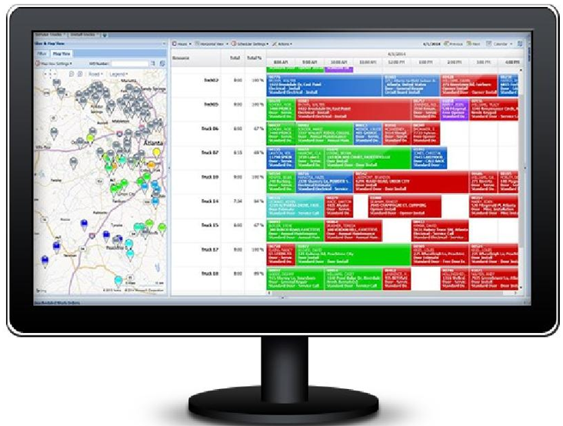
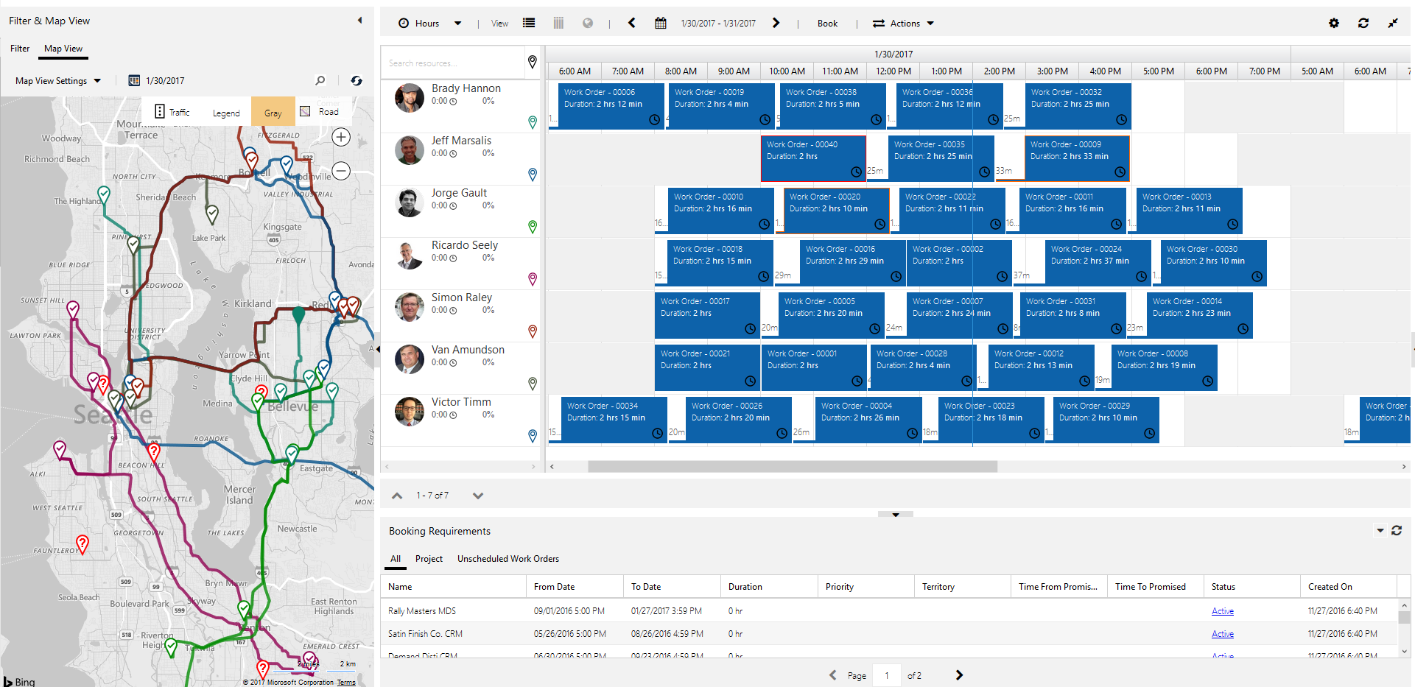
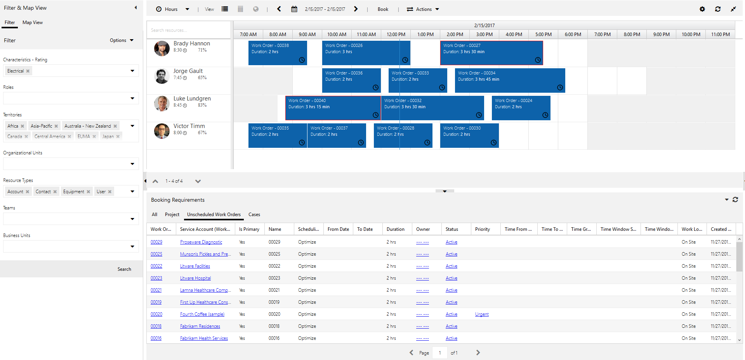
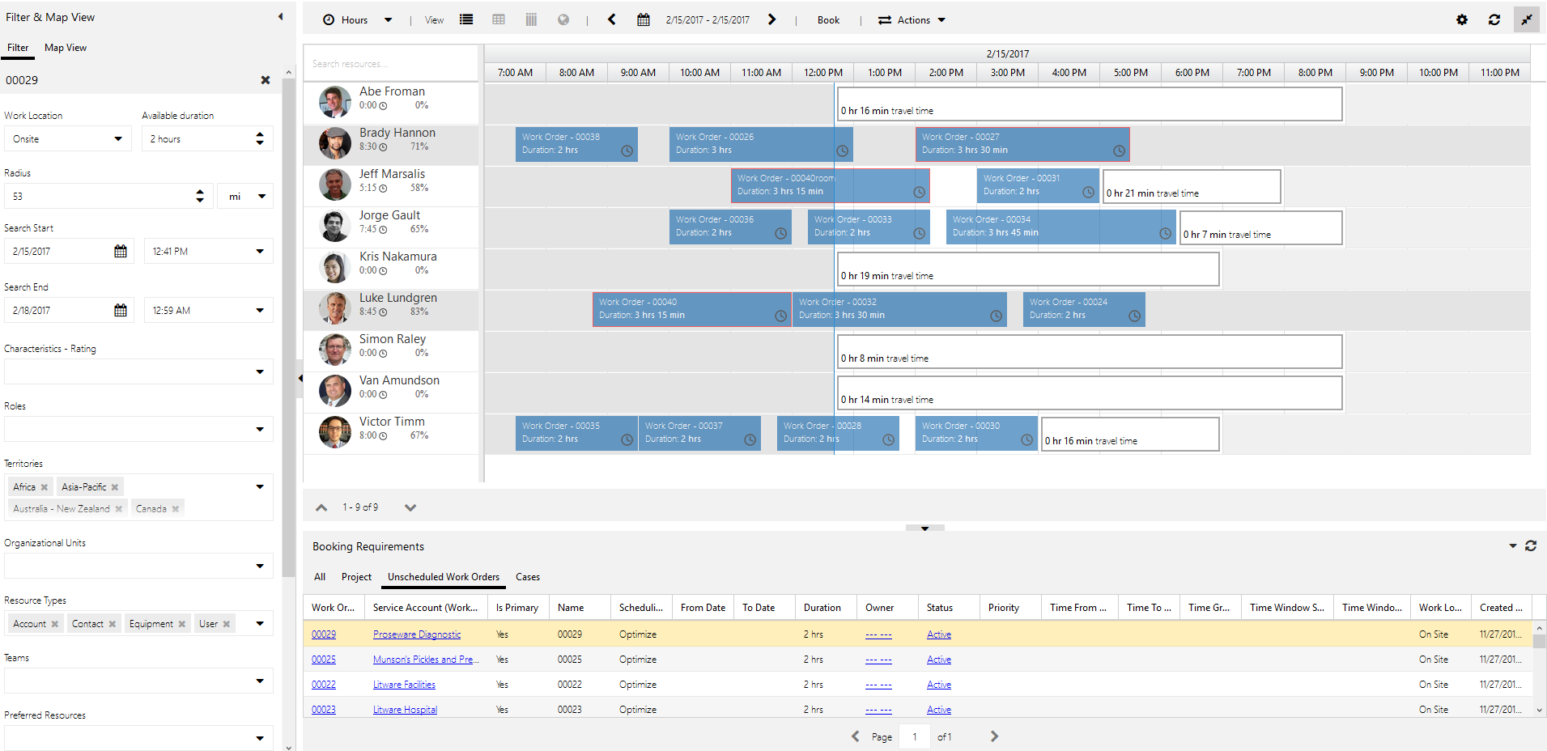
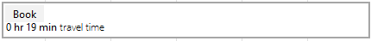
3 ways to schedule
Resource scheduling optimization evaluates routes and automatically schedules work orders to minimize travel time and maximize working hours. The “engine” also responds to reschedules and cancellations. After automatically scheduling, dispatchers still have ability to manually override schedules as needed
Manual service scheduling allows you to click and drag work orders from bottom to resources on top
Scheduling assistant allows you to filter resources on left by travel range, skills, dates, roles, territories and more and the system recommends available resources on right and displays estimated travel time

Slide 25
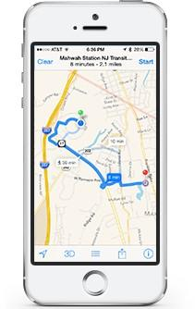
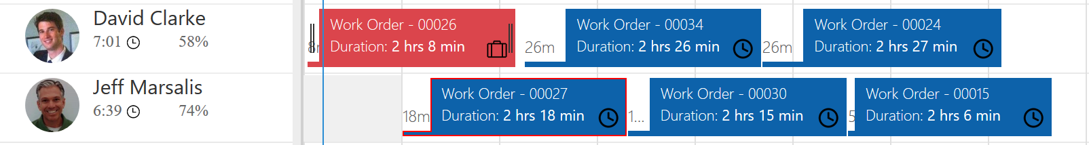
How resource scheduling optimization works
Configure Resource Scheduling Optimization by choosing objectives and constraints and deciding what is most important for your business. As an example, rank importance of minimizing travel time vs. maximizing work hours vs. high priority appointments. This is done with no-code configurations.
Run Resource Scheduling Optimization 3 ways
Via schedule—example—every morning at 8am
Via triggers—example—when a customer cancels
On command with a “Run Now” option.
View Results on the schedule board and mobile devices. Dispatchers will see optimized appointments across all resources on the interactive schedule board. Field agents will see their optimized daily and weekly appointments on their mobile device.

Slide 26

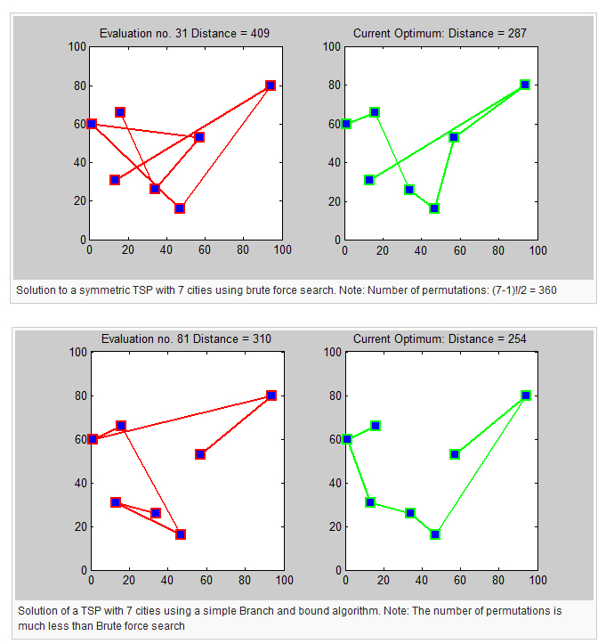
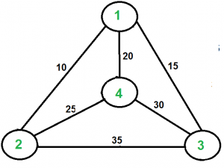
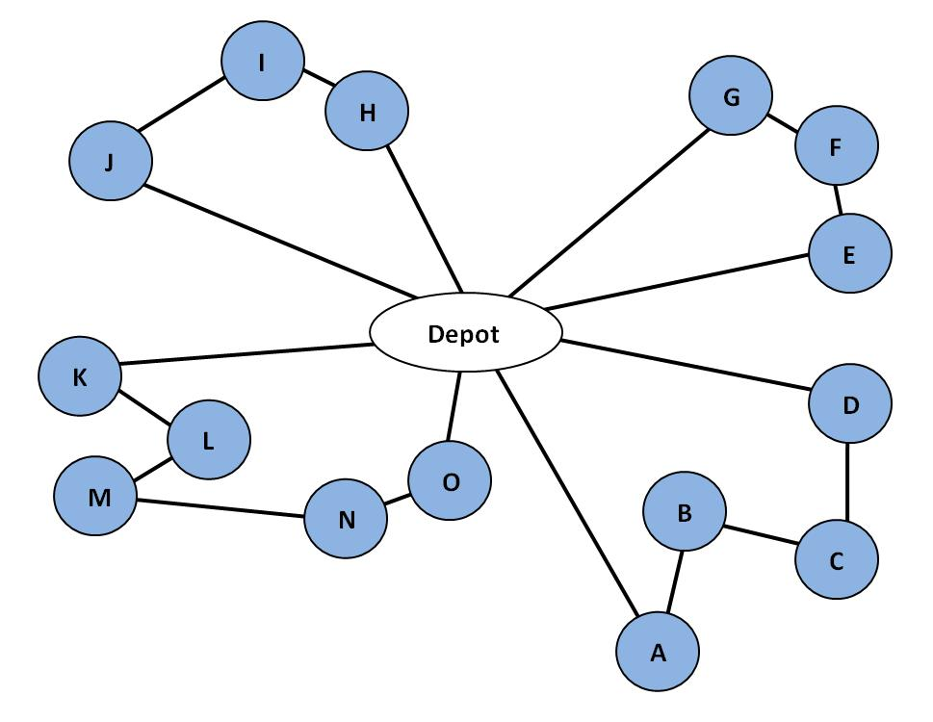

Route optimization history
1.
Our solution is a combination of the Traveling Salesman Problem and the Vehicle Routing Problem
Traveling Salesman Problem - Given a list of cities and the distances between each pair of cities, what is the shortest possible route that visits each city exactly once and returns to the origin city?
TSP mathematically formulated in the 1800s by the early European mathematicians as a recreational puzzle and was first considered mathematically as a solution in the 1930s by Merrill Flood who was looking to solve a school bus routing problem
Vehicle Routing Problem - What is the optimal set of routes for a fleet of vehicles to traverse in order to deliver to a given set of customers?
Schedule / route optimizing is complex: The number of stops increases the number of possibilities exponentially.
1 resource, 4 work orders = 24 possible routes
1R, 10WO = 3,628,800
5R, 10WO = 37,267,043,023,296,000 (quadrillion, trillion, billion, million)
Software is required because a human cannot compute in a timely manner!
2.
1. http://www.geeksforgeeks.org/travelling-salesman-problem-set-1/
2. http://www.researchandpractise.com/vrp/whatisit.html

Slide 27
Demo

Slide 28
Questions?

Slide 29
Thank You

